Slide 1
Master Thesis Introduction Towards Extendable Framework for Big Data Integration and Comparison of Open Source Big Data Integration Tools
Pooja Sompura Harisha Supervisors
Matr-No 362106 Dr.Matthias Jarke, Dr.Christoph Quix
Pooja.harisha@rwth-aachen.de Arnab Chakrabarti

Slide 2

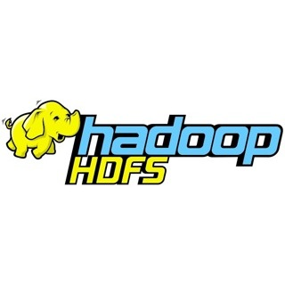
Apache Open Source Big Data Projects
Apache Hadoop: Used for distributed storage and distributed processing of very large data sets.
Apache Hadoop HDFS and YARN: A distributed Java-based file system for storing large volumes of data. YARN and HDFS together form the data management layer of Apache Hadoop.

Slide 3

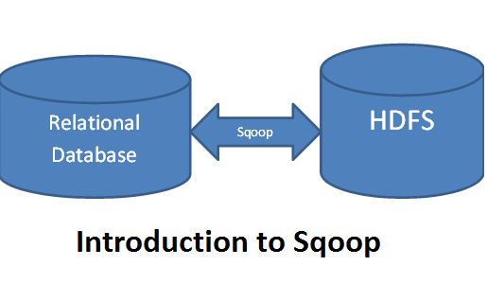

Hadoop Hive: Used to to query, summarize, organize, explore and analyze that data
Apache Sqoop: Efficiently transfers bulk data between Apache Hadoop and structured datastores

Slide 4

Apache Spark: Better framework for Pentaho. Works well on Hadoop system(HDFS & YARN)
Apache Hadoop and Spark will be used as two main frameworks along with the big data integration tools, rest of them will be used as connecters.

Slide 5
Next week: Submitting proposal first draft
Thank you!

Slide 9



BDI Tools:
Talend Open Studio: ETL
Pentaho: Performs MapReduce
Clover ETL
RapidMiner (optional)

Slide 10
Thank you!

